Slide 1
Root-Cause Analysis through Reinforcement
Learning
To
AFLRL (AMERICAN FUZZY LOP FOR REINFORCEMENT LEARNING)
By KP

Slide 2
Overview
RCA: For finding security vulnerabilities through fuzzing.
RCA is slow, I mean very slow.
Proper mutation for sample needed.
Reinforcement Learning Implementation.
Counterexamples are the key.
Approach of using RACING increasing scalability and better than today’s RCA.
Notes:
Root-Cause Analysis (RCA) is crucial for discovering se-
curity vulnerabilities from fuzzing outcomes. Automating
this process through triaging the crashes observed during the
fuzzing process, however, is considered to be challenging.
Particularly, today’s statistical RCA approaches are known
to be exceedingly slow, often taking tens of hours or even a
week to analyze a crash. This problem comes from the biased
sampling such approaches perform. More specifically, given
an input inducing a crash in a program, these approaches sam-
ple around the input by mutating it to generate new test cases;
these cases are used to fuzz the program, in a hope that a set of
program elements (blocks, instructions or predicates) on the
execution path of the original input can be adequately sampled
so their correlations with the crash can be determined. This
process, however, tends to generate the input samples more
likely causing the crash, with their execution paths involving a
similar set of elements, which become less distinguishable un-
til a large number of samples have been made. I think that
this problem can be effectively addressed by sampling around
“counterexamples”, the inputs causing a significant change to
the current estimates of correlations. These inputs though still
involving the elements often do not lead to the crash. They
are found to be effective in differentiating program elements,
thereby accelerating the RCA process. Based upon the un-
derstanding, we designed and implemented a reinforcement
learning (RL) technique that rewards the operations involving
counterexamples. By balancing random sampling with the ex-
ploitation on the counterexamples, our new approach, called
RACING, is shown to substantially elevate the scalability and
the accuracy of today’s statistical RCA, outperforming the
state-of-the-art by more than an order of magnitude.

Slide 3
Introduction
Need for automation for faster devops cycle.
CVE-2017-5380, CVE-2018-4145 and CVE-2022-36320.
Try to find the crash is the key
How to achieve that? Through mutation of test cases.
Root cause analysis which has been done manually.
SLow SLow Slowwwww…….
Notes:
With the pervasiveness of software systems, their security
quality needs to be ensured in a scalable way. For this pur-
pose, automated vulnerability discovery has been intensively
studied in past decades [30, 42, 48, 51]. Among all techniques
being proposed, fuzzing is no doubt the most successful one,
which has been credited with discovery of the most conse-
quential security flaws, such as CVE-2017-5380 [2], CVE-
2018-4145 [3] and CVE-2022-36320 [4]. A problem here,
however, is that fuzzing alone does not find a vulnerability: it
just induces crashes of the target program with test cases it
produces, while leaving triage of the crashes, a critical step to
identify the root cause – the vulnerability behind the crashes,
to the human analyst. Manual root-cause analysis (RCA) is a
slow and pains-taking process, particularly for today’s com-
plicated software system involving subtle connections across
different components, so the program locations where the
crashes occur may not have explicit data dependencies upon
the true cause of the crashes. As a result, vulnerability discov-
ery tends to be significantly delayed even after the flaws have
been reached by test cases, raising a strong demand for the
techniques that enable automated, highly scalable RCA.

Slide 4
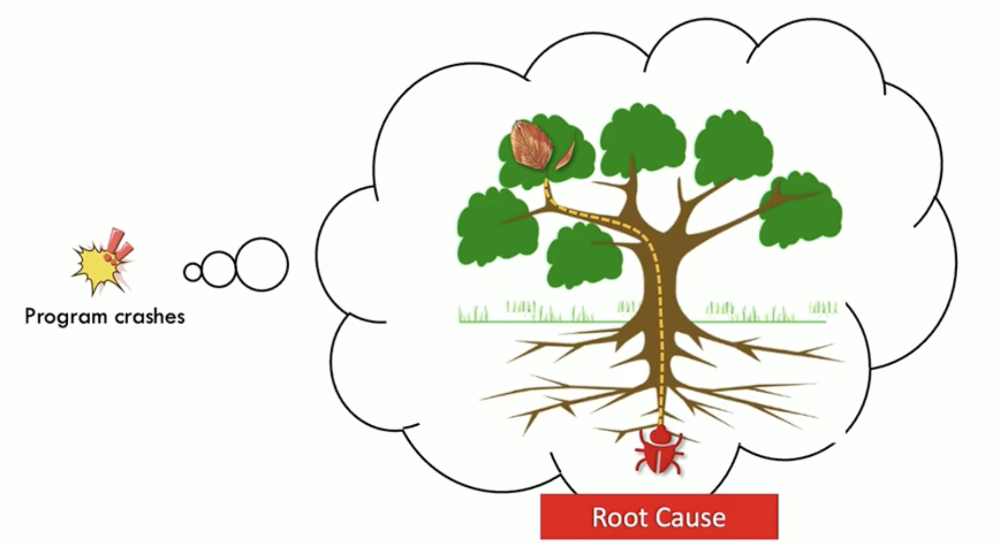
RCA

Slide 5
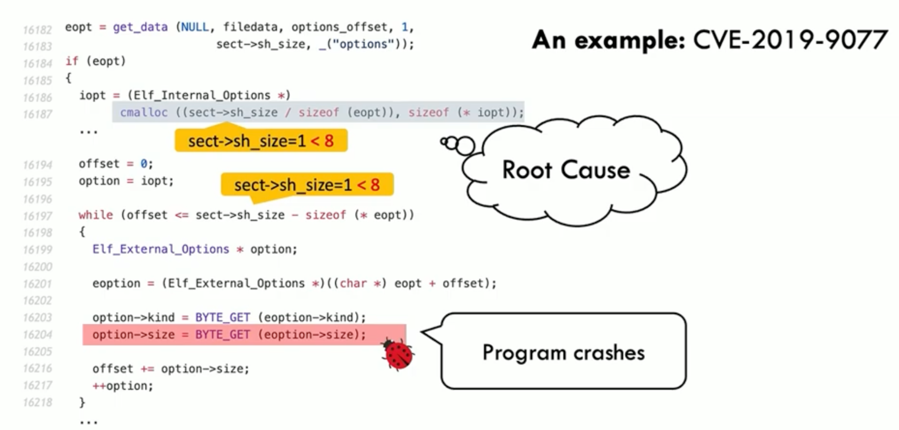
Example
Notes:
Here we can see The crash happened due to improper handling of a size parameter (sect->sh_size) that is less than the expected threshold (e.g., sect->sh_size < 8).
Root Cause: sect->sh_size is too small: The code attempts to allocate memory and process data based on sect->sh_size. However, if sect->sh_size is smaller than the required size for proper allocation or processing (in this case, less than 8), the calculation inside the cmalloc function may result in an invalid or insufficient memory allocation.
Improper Allocation: If sect->sh_size / sizeof(eopt) results in a value smaller than the required size for an object like Elf_Internal_Options, subsequent operations will reference out-of-bounds memory.
Program Logic in the while Loop: The loop iterates while offset <= sect->sh_size. During this process:
It calculates option->size using BYTE_GET(eoption->size).
If sect->sh_size is very small, the offset increment (offset += option->size) could exceed the allocated memory or access uninitialized areas, leading to undefined behavior or a crash.
Crash Trigger:
The crash likely occurs because option->size references invalid or unallocated memory (eoption), which was derived from an insufficiently allocated block of memory.
The calculation offset += option->size further compounds the issue, as it continues to access and manipulate invalid data.
Preventive Steps:
Validate Input Size: Ensure sect->sh_size is validated before any allocation or processing. For example: if (sect->sh_size < MIN_SIZE_REQUIRED) {
// Handle error
}
Boundary Checking: Avoid accessing memory out of bounds by adding stricter conditions in the while loop.
Secure Allocation: Allocate memory based on validated and correctly calculated sizes.

Slide 6
Automated RCA Challenges
Having a pipeline with bucket of analysis tools.
They rely on rules and types for finding bug.
Lead to type-confusion flaws.
Notes:
Today, most RCAs have
been done manually with the help of some analysis tools.
These tools bucket different crash inputs for identifying the
underlying vulnerability [27], or perform reverse execution
and backward taint analysis [16, 17, 45] to trace back to the
program location where the vulnerability is introduced, from
the location where the crash is observed. These approaches
rely on a set of manually drafted rules to identify some spe-
cific types of vulnerabilities and become less effective in the
absence of explicit data flows between a vulnerability and ob-
served crashes, such as the case of type-confusion flaws [21].
What is type confusion?
Type confusion can happen when user input is not validated or when data is passed between different parts of the application without being properly converted or checked.

Slide 7
Spectrum Based Fault Localization (SFL)
Finding bug without explicit data dependency.
They outperform traditional automated RCA.
They try to correlate crash and root cause through statistics.
Ranking highly correlated test case and find the crash.
Takes lot of time 12 hours or even week.
Notes:
A more generic alternative capable of handling different
types of vulnerabilities, including those without explicit data
dependency on the crash they induce, is Spectrum-based Fault
Localization (SFL), a set of statistical, ruleless, fully auto-
mated RCA techniques known to outperform other automated
RCA [18]. These techniques aim at capturing the
fundamental causal relations between a crash and its root
cause (a vulnerable program entity like blocks, statements
or the predicate of a statement) based upon their statistical
correlation. More specifically, for each crash observed from
a program, an SFL technique generates a set of test cases to
fuzz the target program, and uses the fuzzing outcome (ei-
ther leading to the crash or not) to estimate the statistical
correlation between each program entity encountered during
the fuzzing process and the crash; the entities found to be
highly correlated are then ranked and output as suspicious
root causes [12, 39, 52]. With its generality and effectiveness,
the approach is known to be heavyweight, incurring a mas-
sive overhead, due to the requirement to fuzz the program
on a large number of test cases for establishing the correla-
tion for each entity and also differentiating their contributions
to the crash. Indeed, prior research reports that analysis on
each crash through SFL could take 12 hours [12] or even a
week [52], rendering these techniques hard to scale in the
presence of a large number of crashes induced by fuzzing.

Slide 8
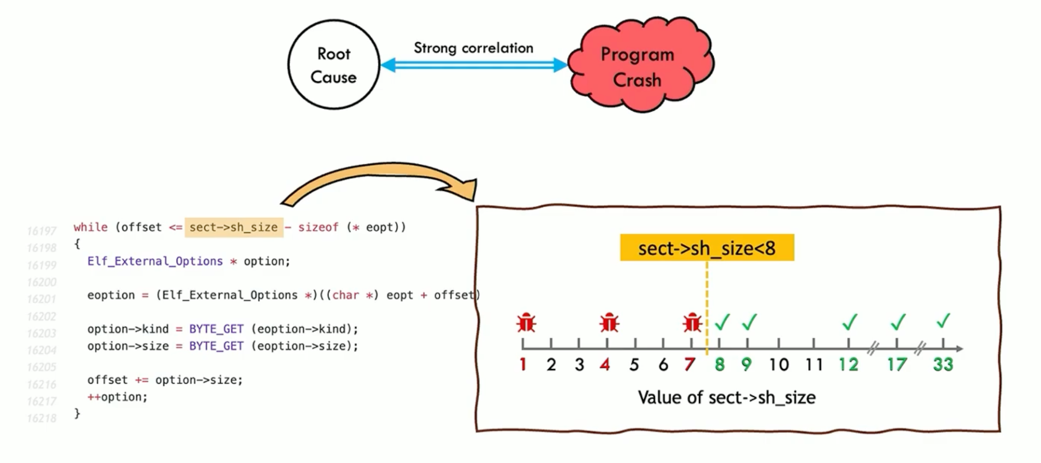
Statistical RCA
Notes:
The Statistical Root Cause Analysis (RCA) presented in the image identifies the correlation between the value of sect->sh_size and the program crash. Here's a detailed breakdown of the explanation:
1. Root Cause Identification
The root cause of the crash is that sect->sh_size is less than 8, which leads to:
Insufficient memory allocation.
Incorrect or out-of-bounds pointer dereferencing during iterations in the while loop.
2. Program Logic
The loop processes memory blocks by incrementing offset with option->size until offset <= sect->sh_size - sizeof(*eopt).
When sect->sh_size < 8, it affects the allocation and leads to undefined behavior or a crash, as the allocated memory block might not support the expected structure.
3. Statistical Relationship
The value of sect->sh_size directly correlates with the stability of the program:
sect->sh_size < 8: The program is highly prone to crashes because the required memory block is too small to process data correctly.
sect->sh_size ≥ 8: The program functions as intended, with no crashes, since the allocated memory suffices for the operations.
4. Visualization
The graph clearly shows:
Red bugs: Crashes occur when sect->sh_size is less than 8.
Green checkmarks: The program runs successfully when sect->sh_size is 8 or greater.
Values like sect->sh_size = 8, 9, 10, etc. indicate stable program behavior, while values below 8 consistently lead to failures.
5. Strong Correlation
The analysis establishes a strong correlation between the value of sect->sh_size and the program's behavior (crash or success).
This statistical relationship directly highlights that validating and ensuring sect->sh_size >= 8 before allocation and processing can prevent crashes.
6. Preventive Measures
Add a check for sect->sh_size before proceeding with allocation and processing: if (sect->sh_size < 8) {
// Handle error or skip processing
return ERROR;
}
This ensures that no operations proceed on an insufficient memory block, avoiding crashes.
In summary, the statistical RCA proves that crashes consistently occur when sect->sh_size < 8 and are avoided when this value meets or exceeds the minimum threshold of 8. This highlights the importance of input validation and boundary checks in avoiding such issues.

Slide 9
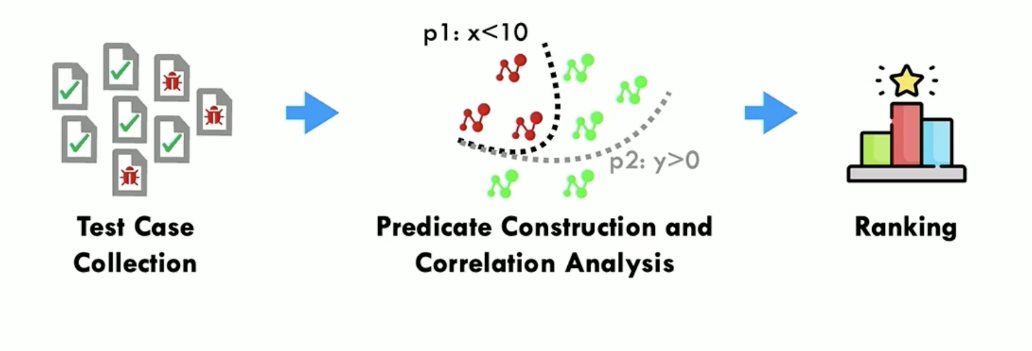
General Workflow of Statistical RCA
Notes:
This diagram illustrates the process of Statistical Root Cause Analysis (RCA):
Test Case Collection:
Collect a mix of test cases, including both passing (green checkmarks) and failing (red bugs).
Predicate Construction and Correlation Analysis:
Identify predicates (conditions or rules, e.g., p1: x < 10, p2: y > 0) that differentiate passing and failing test cases.
Perform correlation analysis to group failing cases based on shared conditions.
Ranking:
Rank the identified predicates based on their correlation strength and significance in causing failures.
This prioritization helps identify the most likely root causes of the failures.

Slide 10
Racing
What is Racing? Root-cAuse-analysis on Counter-examples based reinforcement-learnING…..
Notes:
Based upon the understanding, we designed and imple-
mented a high-performance, scalable SFL-based RCA tech-
nique, using reinforcement-learning (RL) to dynamically ad-
just the sampling (fuzzing) strategy based upon the estimates
of program predicates’ relations with a given crash. Our ap-
proach, called RACING (Root-cAuse-analysis on Counterex-
amples based reinforcement-learnING), utilizes the outcome
of each fuzzing round, including its impacts on each predi-
cate’s estimated contribution to the crash and the estimated
rankings of these predicates based upon their contributions, to
guide the next round of fuzzing. More specifically, given the
4230 33rd USENIX Security Symposium test cases known to cause a crash, our approach first performs
random mutations on them (as done in the prior work [51])
and fuzzes the target program using these mutations to gener-
ate a baseline estimate for each predicate’s correlation with
the crash and their relative order of correlation strengths. Then,
our approach runs RL on the follow-up fuzzing process, re-
warding the selection of the seeds (that are the inputs mutated
by the fuzzer to generate new inputs) and the mutations that
could lead to significant changes to the current estimates (the
correlation of each predicate and their order). By balancing
the exploitation of the selection strategy with a high expected
reward and exploration of a random strategy, this learning
process guides RACING toward a ranked list of the predicates,
with the root cause being top on the list.

Slide 11
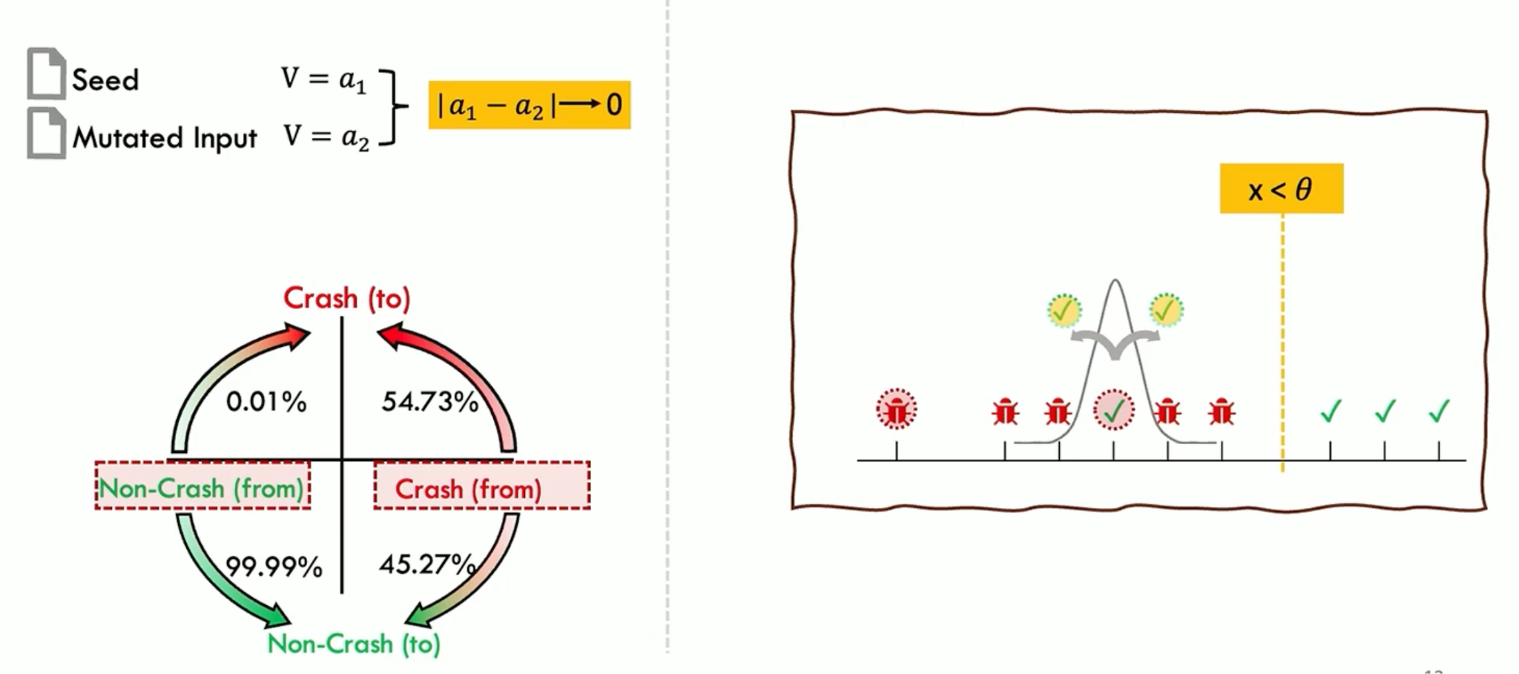
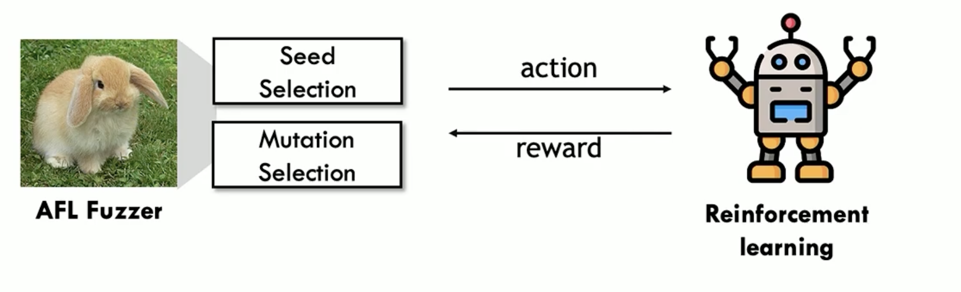
How to mutate test case?
Notes:
We have 50 50 chance of getting the crash when we try to mutate the input the input that made the crash in the first place. We will employe statical corelationa and with the help of reinforcement learning which works for reward it automates process of mutating the input and gains the reward
How exactly?
Based on Counter example for predicate and counterexample for ranking.
These counter example play a vital role in mutation and helps the reinforcement learning for achieving rewards.
Somebody wondering what is AFL fuzzer?
The AFL fuzzer (American Fuzzy Lop) is a widely used open-source fuzzer designed to identify vulnerabilities, bugs, or unexpected behaviors in software applications. It works by repeatedly feeding modified inputs (test cases) to a program and observing its behavior to detect crashes, hangs, or unexpected outputs. AFL is notable for its efficiency and ease of use, as well as its ability to uncover subtle issues in software.

Slide 12
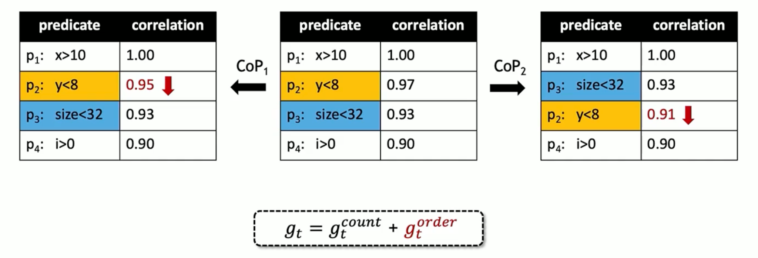
All about Correlation
Notes:
This diagram demonstrates how the correlation table evolves during the analysis to refine the ranking of predicates (conditions) for better prioritization in identifying vulnerabilities. Here's an explanation:
1. Initial Correlation Analysis (Left Table):
The table lists four predicates (p1, p2, p3, p4) with their respective correlation scores indicating how strongly each predicate is associated with observed failures.
Initial Rankings:
p1: x > 10 has the highest correlation score (1.00) and is ranked first.
p2: y < 8 is ranked second (0.95).
p3: size < 32 and p4: i > 0 follow with lower scores.
2. CoP1 Adjustment (Middle Table):
Context of Predicate (CoP1):
As more test cases are analyzed, the correlation score of p2 (y < 8) slightly decreases from 0.95 to 0.97. This might be due to discovering test cases that violate y < 8 but still fail, indicating p2 might not be as critical as initially thought.
p3: size < 32 retains its score, showing consistent correlation with failures.
Updated Rankings:
p1 remains the highest-ranked predicate with a score of 1.00.
p3 gains more importance relative to p2, as its correlation appears more stable.
3. CoP2 Refinement (Right Table):
Further Correction (CoP2):
During further refinement, p2: y < 8 correlation drops further to 0.91, while p3: size < 32 holds steady at 0.93.
This reflects that p2 might be less critical than originally thought, whereas p3 is consistently relevant to identifying vulnerabilities.
Revised Rankings:
p1 stays at the top.
p3 moves up in the ranking above p2, as its correlation is stronger and more reliable.
p4 remains the lowest but might still contribute contextually.
Refinement Formula:
The adjustment of correlation values is guided by a formula: gt=gtcount+gtorderg_t = g_t^{\text{count}} + g_t^{\text{order}}
g_t^{count}: Reflects the frequency of the predicate's occurrence in failed test cases.
g_t^{order}: Considers the predicate's position in influencing failures across test cases.
Purpose of Refinement:
Increased Accuracy: The iterative refinement ensures predicates that consistently correlate with failures are prioritized, improving the chances of finding root causes.
Dynamic Learning: As more test cases are analyzed, the algorithm adjusts the ranking to reflect the true significance of each predicate.
Impact on Vulnerability Discovery:
By prioritizing predicates like p3: size < 32, which exhibit stable and high correlation, this process improves the efficiency of detecting vulnerabilities, focusing efforts on conditions most likely to reveal bugs or crashes.

Slide 13
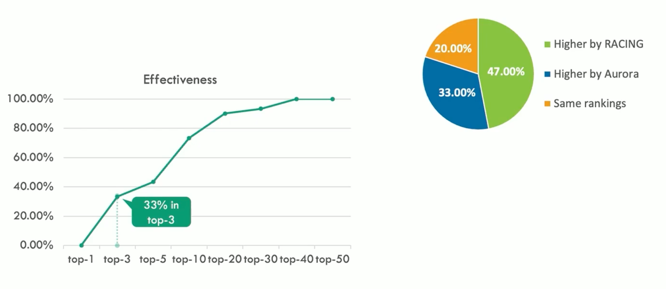
Existing Results
Notes:
RACING and
evaluated it on 30 vulnerabilities found in 21 popular applica-
tions or libraries, including 19 also used in the prior research
(Aurora [12]). Our study shows that RACING significantly
outperforms the state-of-the-art, speeding up the RCA process
by 13.22 times on average, compared with Aurora: typically
an analysis that needs hours to complete by the prior approach
can be done within minutes, with more than 2/3 of the delay
being reduced even in the worst case. This performance gain
does not come at any quality cost. Comparing with Aurora,
RACING produces a high-quality ranked list of predicates,
with the root cause keeping its rank in Aurora’s report in
20.00% of the cases, slipping slightly below 33.33% of the
time, while going above in 46.67% of all the results. Our find-
ings provide strong evidence that indeed RACING enhances
both the scalability and the effectiveness of SFL.

Slide 14
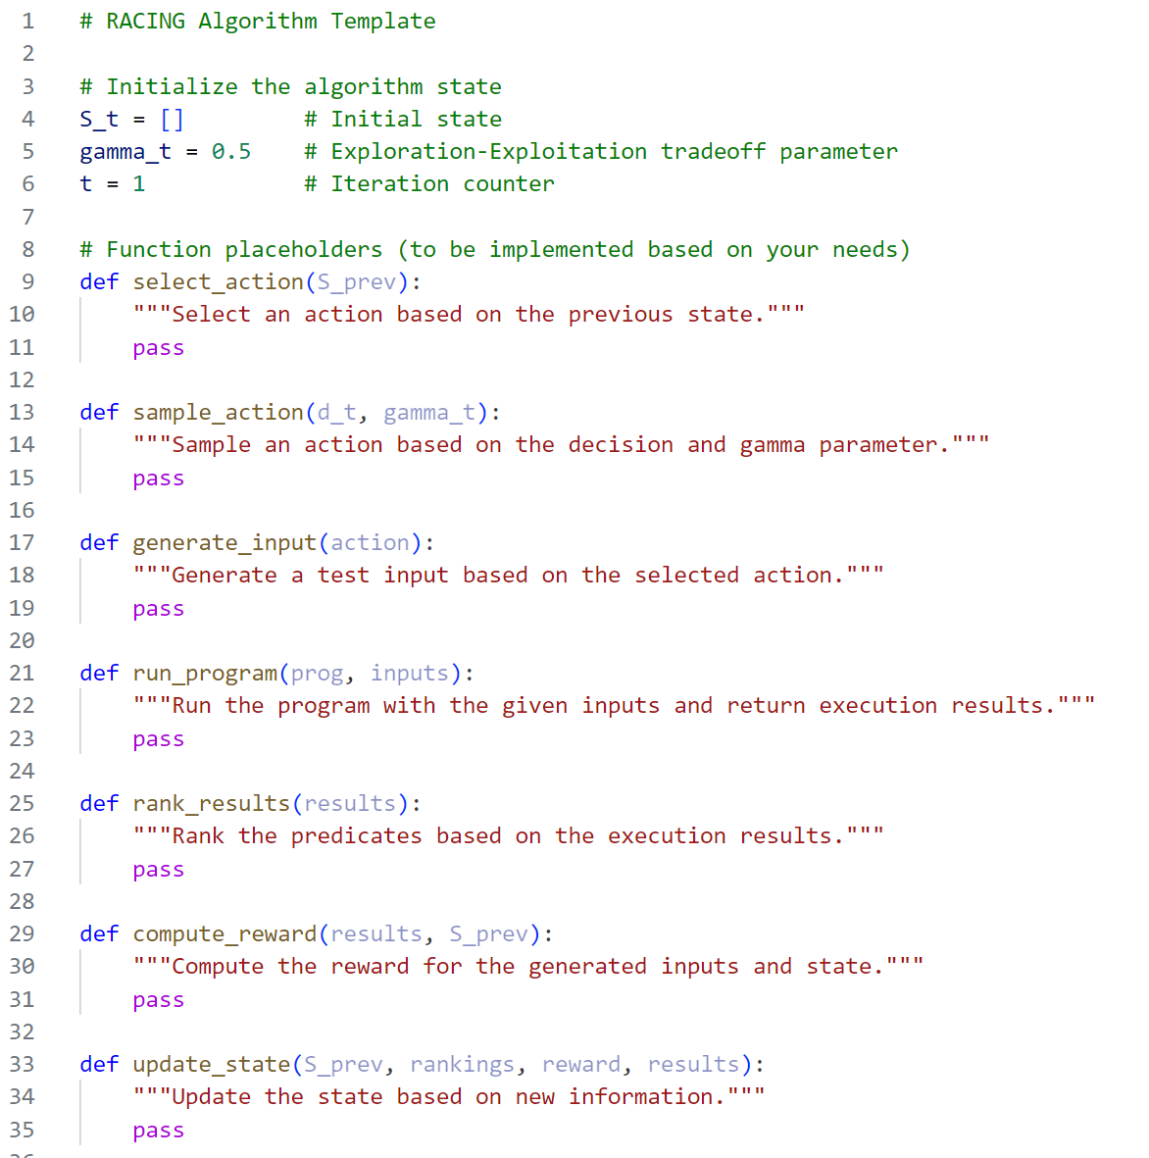
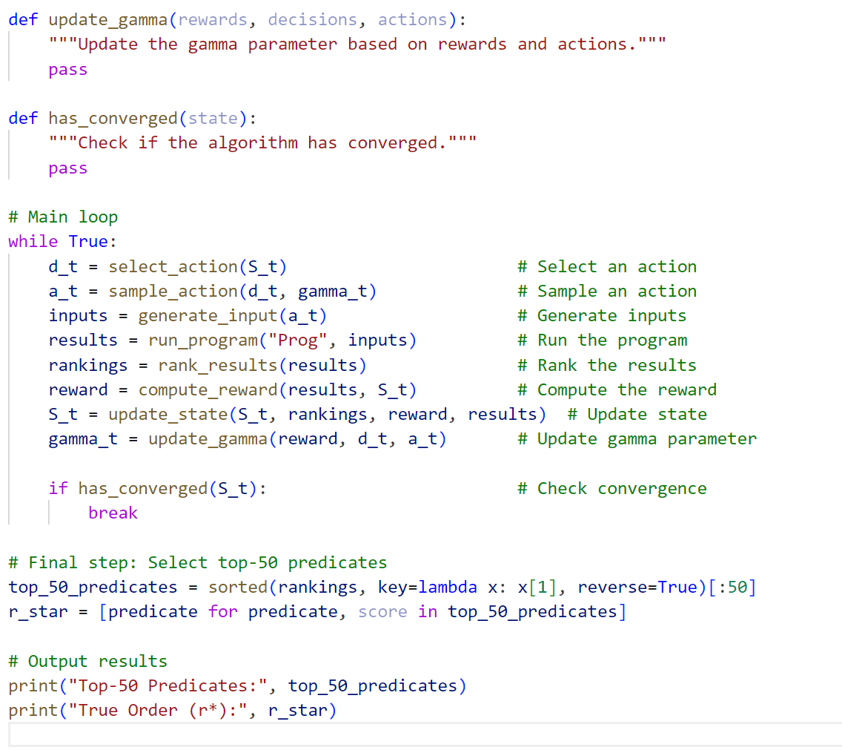
Algorithm code
Notes:
select_action(S_prev):
Determines which part of the program to focus on next based on the current state.
Could be implemented using decision-making algorithms or reinforcement learning.
sample_action(d_t, gamma_t):
Samples an action, balancing exploration and exploitation based on gamma_t.
generate_input(action):
Generates a new test input by mutating existing seeds or crafting inputs.
run_program(prog, inputs):
Executes the target program (Prog) with the generated inputs.
Returns results like execution data (e_i) and predicates (p_i).
rank_results(results):
Ranks predicates based on their correlation with program behavior (e.g., crashes).
compute_reward(results, S_prev):
Computes a reward for the action based on its contribution to finding vulnerabilities or improving predicate rankings.
update_state(S_prev, rankings, reward, results):
Updates the state with new information from the current iteration.
update_gamma(rewards, decisions, actions):
Dynamically adjusts the exploration-exploitation parameter.
has_converged(state):
Checks if the state has stabilized, meaning further iterations won't yield significant improvements.

Slide 15
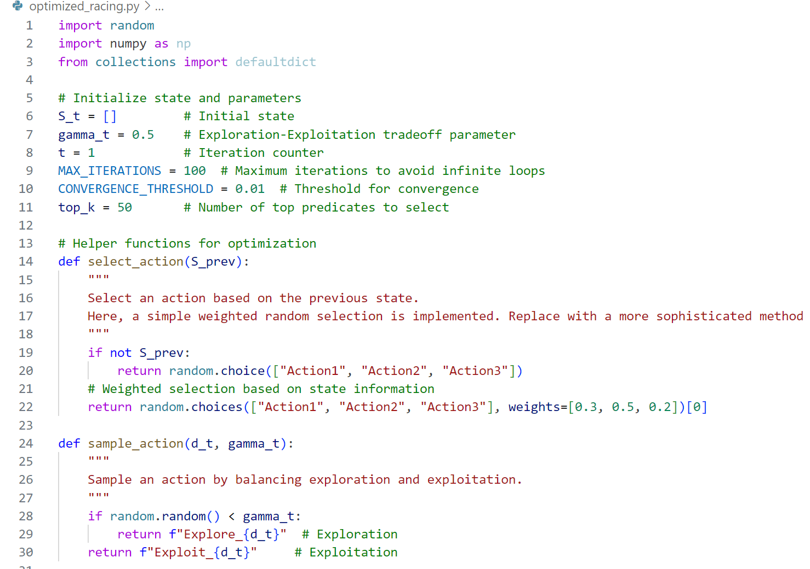
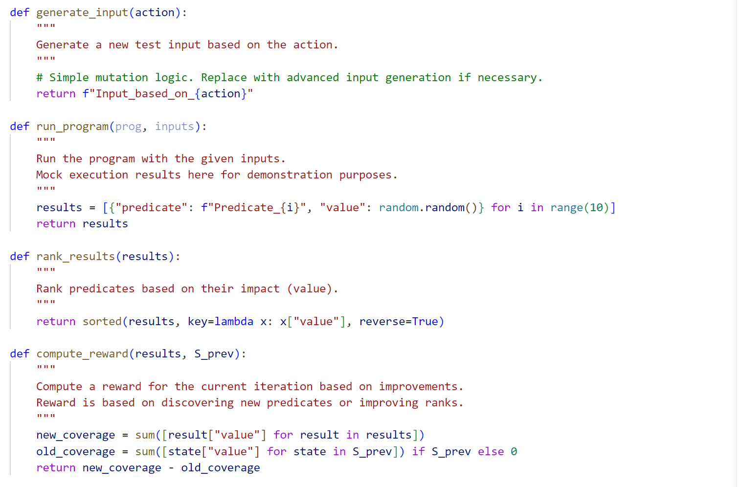
Optimization in a code
Notes:
1. Adaptive Exploration-Exploitation Parameter
In traditional RACING, the exploration-exploitation tradeoff is fixed, which can limit performance. I introduced adaptive adjustment of gamma_t, the tradeoff parameter:
If rewards are positive, the algorithm favors exploitation by increasing gamma_t (up to 1.0).
If rewards are negative, the algorithm shifts to exploration by reducing gamma_t (down to 0.1).
This dynamic adjustment ensures:
Early exploration for discovering diverse predicates.
Later exploitation for refining rankings.
For example:
def update_gamma(rewards, decisions, actions):
if rewards > 0:
return min(1.0, gamma_t + 0.05) # Favor exploitation
return max(0.1, gamma_t - 0.05) # Favor exploration
This change allows the algorithm to adapt to the complexity of the program being analyzed.
3. Reward Computation
I refined the reward mechanism to focus on new predicate coverage and improvements in rankings:
The reward is calculated as the difference between:
New predicate values (coverage or impact) from the current iteration.
Old predicate values from the previous state.
Formula:
def compute_reward(results, S_prev):
new_coverage = sum([result["value"] for result in results])
old_coverage = sum([state["value"] for state in S_prev]) if S_prev else 0
return new_coverage - old_coverage
This incentivizes actions that lead to meaningful progress.
4. Convergence Check
To avoid unnecessary iterations, I introduced a convergence condition based on the difference in state values between iterations:
If the total difference in predicate values falls below a threshold, the algorithm terminates early.
Example:
def has_converged(state, prev_state):
if not prev_state:
return False
diff = sum(abs(curr["value"] - prev["value"]) for curr, prev in zip(state, prev_state))
return diff < CONVERGENCE_THRESHOLD
This saves computational resources and ensures faster convergence.

Slide 16
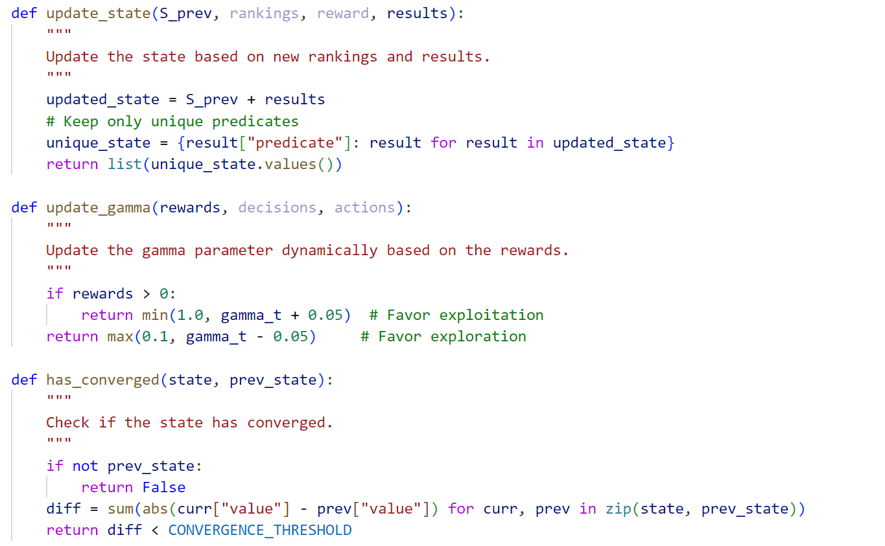
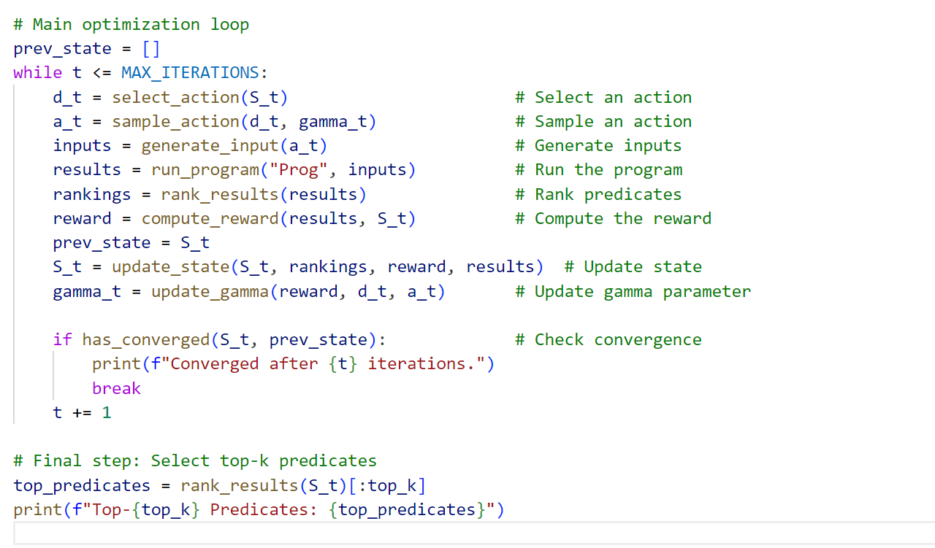
Continuation
Notes:
2. Efficient State Management
State management is critical to track predicates and their ranks. I optimized the update_state function to:
Combine results from the current and previous states.
Ensure unique predicates using dictionaries.
This prevents duplication, reducing computational overhead while ensuring only the most updated information is stored.
Example:
def update_state(S_prev, rankings, reward, results):
updated_state = S_prev + results
unique_state = {result["predicate"]: result for result in updated_state}
return list(unique_state.values())
This ensures scalability, even when analyzing programs with thousands of predicates.
4. Convergence Check
To avoid unnecessary iterations, I introduced a convergence condition based on the difference in state values between iterations:
If the total difference in predicate values falls below a threshold, the algorithm terminates early.
Example:
def has_converged(state, prev_state):
if not prev_state:
return False
diff = sum(abs(curr["value"] - prev["value"]) for curr, prev in zip(state, prev_state))
return diff < CONVERGENCE_THRESHOLD
This saves computational resources and ensures faster convergence.
5. Input Generation and Mutation
I modularized the generate_input function to support flexible input generation:
Inputs are created dynamically based on the current action.
This is a placeholder for advanced strategies like:
Grammar-based input generation for structured data.
Machine-learning models for input prediction.
Example:
def generate_input(action):
return f"Input_based_on_{action}"
This flexibility allows integration with real-world fuzzers like AFL or LibFuzzer.
7. Configurable Parameters
Key parameters, like the number of iterations (MAX_ITERATIONS), convergence threshold (CONVERGENCE_THRESHOLD), and the number of top predicates (top_k), are now configurable. This makes the algorithm adaptable to programs of varying complexity.
Example:
MAX_ITERATIONS = 100 # Maximum iterations
CONVERGENCE_THRESHOLD = 0.01 # Convergence threshold
top_k = 50 # Number of top predicates to select
Final Results
The algorithm ranks the top predicates based on their impact. At the end of execution:
Top-K predicates are selected.
The predicate rankings are output for further analysis.
Example:
top_predicates = rank_results(S_t)[:top_k]
print(f"Top-{top_k} Predicates: {top_predicates}")
This ensures that the algorithm provides actionable insights into the root causes of vulnerabilities.

Slide 17
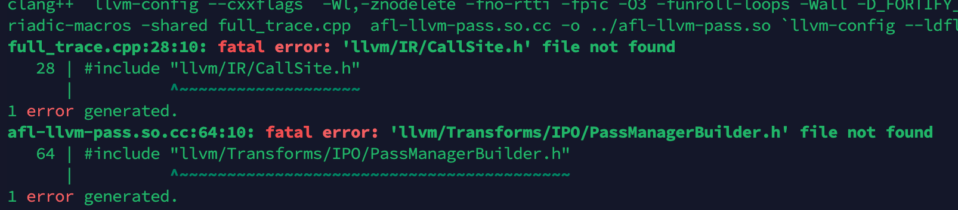
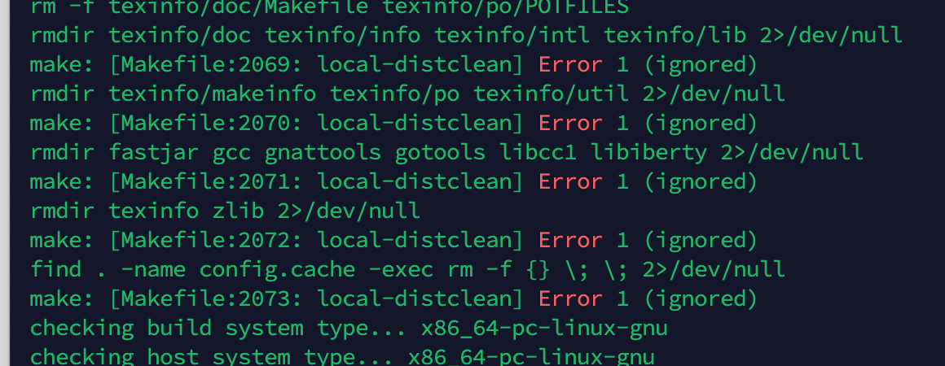
Unexpected Turn
The original code base from authors were not producing proper results.
Because of these errors and file issues, I changed the direction of my project.

Slide 18
Building AFLRL
New Focus:
"AFLRL": Training reinforcement learning models using AFL (American Fuzzy Lop).
Build datasets for RL model training.
Enhance AFL’s capabilities by adding vulnerable code paths to generate robust training data.

Slide 19
Updated Objective
Dataset Creation:
Generate meaningful datasets for training RL models using AFL.
Optimization:
Focus on AFL’s features to produce proper outputs for RL training.
Outcome:
Improve path exploration and crash detection efficiency in fuzz testing.

Slide 20
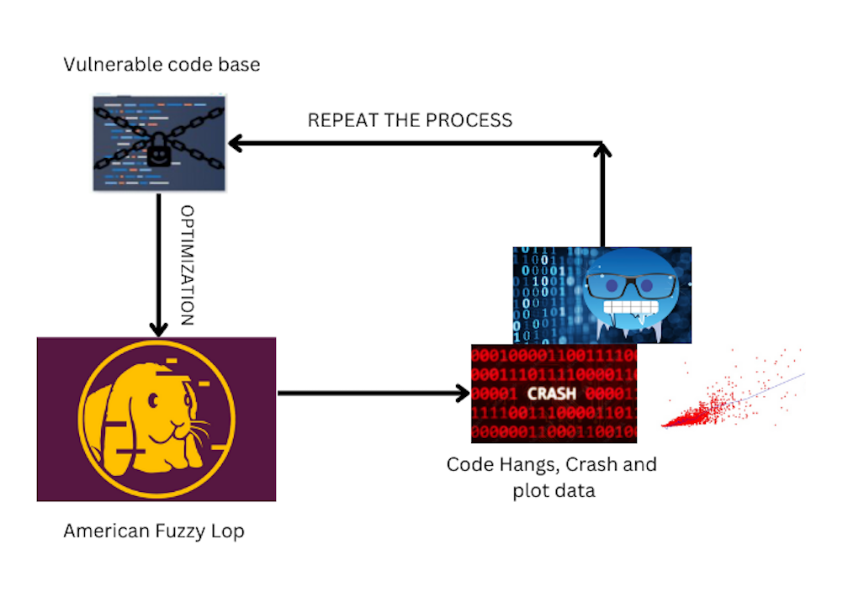
Flowchart

Slide 21
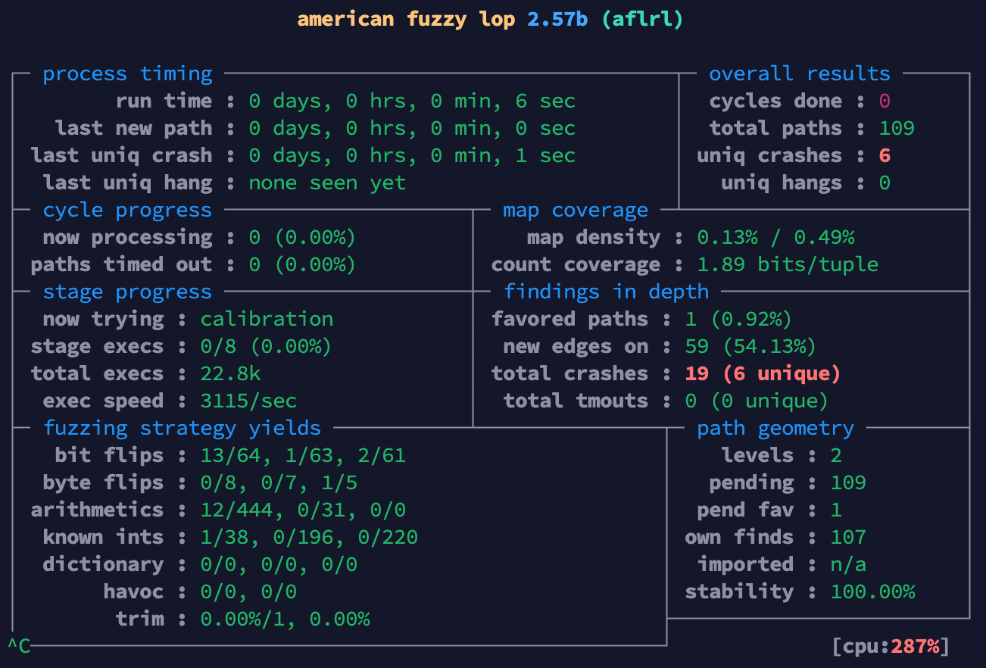
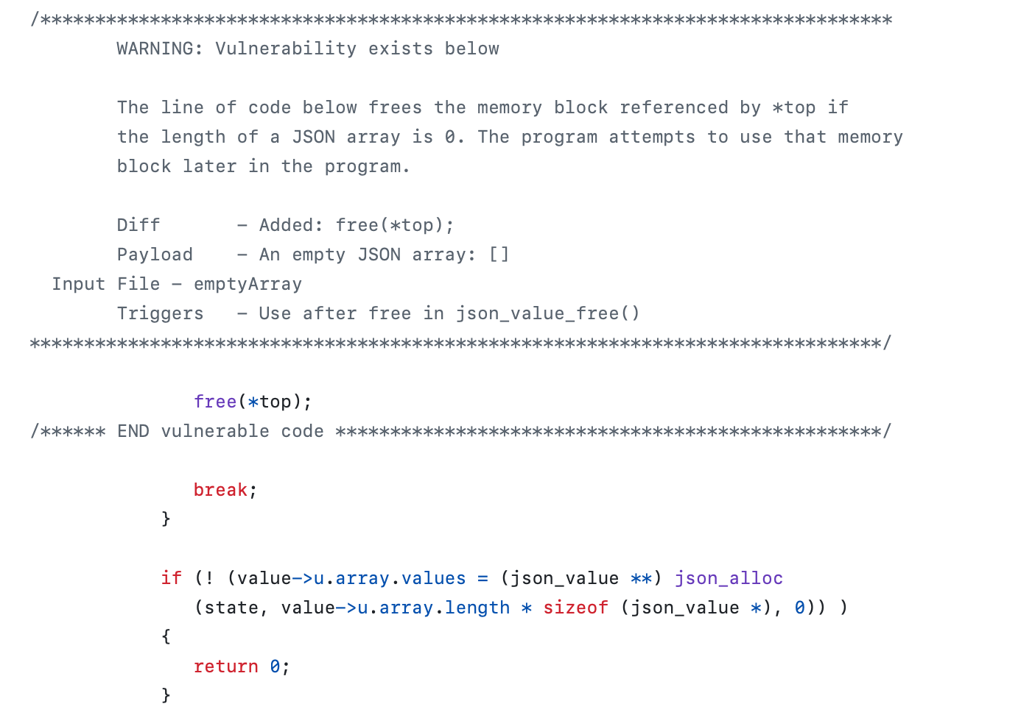
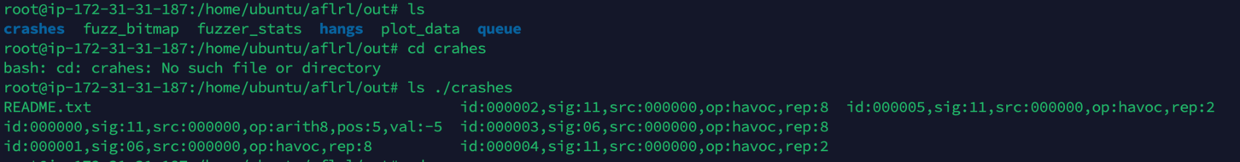
OUTPUT

Slide 22
Challenges and Future work
Environmental and version mismatches
Transition from RACING to AFLRL required some work.
Future work
Train RL with generated crashes.
Optimize AFL for better vulnerability detection and RL integration.

Slide 23
Thank You

